Slide 1
CSS(Cascading Style Sheets )

Slide 2
CSS for Styling
CSS stands for Cascading Style Sheets CSS Saves a Lot of Work!
Describes the appearance, layout, and presentation of information on a web page
HTML describes the content of the page
Describes how information is to be displayed, not what is being displayed
Can be embedded in HTML document or placed into separate .css file
Styles are normally saved in external .css files. External style sheets enable you to change the appearance and layout of all the pages in a Web site, just by editing one single file!

Slide 3
CSS History
CSS has various levels and profiles. Each level of CSS builds upon the last, typically adding new features and typically denoted as CSS1, CSS2, and CSS3.
The first CSS specification to become an official W3C Recommendation is CSS level 1, published in December 1996
CSS level 2 was developed by the W3C and published as a Recommendation in May 1998. A superset of CSS1, CSS2 includes a number of new capabilities like absolute, relative, and fixed positioning of elements and z-index, the concept of media types etc.
CSS 3
CSS level 3 is currently under development. The W3C maintains a CSS3 progress report.

Slide 4
Advantages of CSS
CSS saves time When most of us first learn HTML, we get taught to set the font face, size, colour, style etc every time it occurs on a page. This means we find ourselves typing (or copying & pasting) the same thing over and over again. With CSS, you only have to specify these details once for any element. CSS will automatically apply the specified styles whenever that element occurs.
Pages load faster Less code means faster download times.
Easy maintenance To change the style of an element, you only have to make an edit in one place.
Superior styles to HTML CSS has a much wider array of attributes than HTML.

Slide 5
Disadvantages of CSS
Browser compatibility Browsers have varying levels of compliance with Style Sheets. This means that some Style Sheet features are supported and some aren't. To confuse things more, some browser manufacturers decide to come up with their own proprietary tags.

Slide 6
Basic CSS rule syntax
selector {
property: value;
property: value;
...
property: value;
} CSS
p {
font-family: sans-serif;
color: red;
} CSS
A CSS file consists of one or more rules
Each rule starts with a selector
A selector specifies an HTML element(s) and then applies style properties to them
a selector of * selects all elements

Slide 7
Understanding Style Rules
A Style Rule is composed of two parts: a selector and a declaration.
TH {color: red;}.
The Selector indicates the element to which the rule is applied.
The Declaration determines the property values of a selector.
Declaration
Selector
Notes:
7
The header cell of a table

Slide 8
Understanding Style Rules
Property
Value
The Property specifies a characteristic, such as color, font-family, position, and is followed by a colon (:).
The Value expresses specification of a property, such as red for color, arial for font family, 12 pt for font-size, and is followed by a semicolon (;).
P {color: red;}

Slide 9
Attaching a CSS file <link>
<head>
...
<link href="filename" type="text/css" rel="stylesheet" />
...
</head> HTML
<link href="style.css" type="text/css" rel="stylesheet" />
<link href="http://www.google.com/uds/css/gsearch.css"
rel="stylesheet" type="text/css" /> HTML
A page can link to multiple style sheet files
In case of a conflict (two sheets define a style for the same HTML element), the latter sheet's properties will be used
Notes:
a conflict (two sheets define a style for the same HTML element

Slide 10
Embedding style sheets: <style>
<head>
<style type="text/css">
p { font-family: sans-serif; color: red; }
h2 { background-color: yellow; }
</style>
</head>
HTML
CSS code can be embedded within the head of an HTML page
Bad style and should be avoided when possible (why?)

Slide 11
Inline styles: the style attribute
<p style="font-family: sans-serif; color: red;">
This is a paragraph</p>
HTML
This is a paragraph
output
Higher precedence than embedded or linked styles
Used for one-time overrides and styling a particular element
Bad style and should be avoided when possible (why?)

Slide 12
CSS properties for colors
p {
color: red;
background-color: yellow;
}
CSS
This paragraph uses the style above output
property | description
color | color of the element's text
background-color | color that will appear behind the element

Slide 13
Specifying colors
p { color: red; }
h2 { color: rgb(128, 0, 196); }
h4 { color: #FF8800; } CSS
This paragraph uses the first style above
This h2 uses the second style above.
This h4 uses the third style above.
output
color names: aqua, black, blue, fuchsia, gray, green, lime, maroon, navy, olive, purple, red, silver, teal, white (white), yellow
RGB codes: red, green, and blue values from 0 (none) to 255 (full)
hex codes: RGB values in base-16 from 00 (0, none) to FF (255, full)

Slide 14
Grouping styles
p, h1, h2 {
color: green;
}
h2 {
background-color: yellow;
} CSS
This paragraph uses the above style.
output
This h2 uses the above styles.
A style can select multiple elements separated by commas
The individual elements can also have their own styles

Slide 15
CSS comments /*…*/
/* This is a comment.
It can span many lines in the CSS file. */
p {
color: red; background-color: aqua;
} CSS
CSS (like HTML) is usually not commented as rigorously as programming languages such as Java
The // single-line comment style is NOT supported in CSS
The <!-- ... --> HTML comment style is also NOT supported in CSS

Slide 16
CSS Padding
he CSS padding properties are used to generate space around content.
The padding clears an area around the content (inside the border) of an element.
With CSS, you have full control over the padding. There are CSS properties for setting the padding for each side of an element (top, right, bottom, and left).

Slide 17
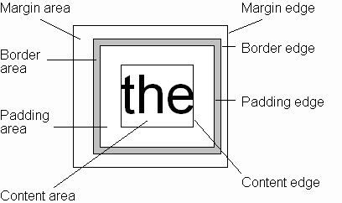
CSS Box Model
Every rendered element occupies a box:
(or outer edge)
(or inner edge)

Slide 18
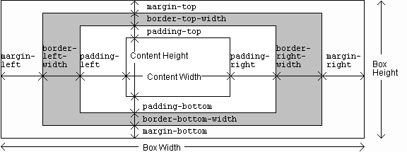
CSS Box Model

Slide 19
CSS has properties for specifying the padding for each side of an element:
p{
padding-top: 10px;
padding-right: 20 px;
padding-bottom: 30 px;
padding-left: 20 px;
}
All the padding properties can have the following values:
length - specifies a padding in px, pt, cm, etc.
% - specifies a padding in % of the width of the containing element

Slide 20
ID Selectors
CSS
#logo {declaration}
HTML
<img id=”logo” src=”” alt=””>
An ID is an html attribute that is added to your html markup. You reference that ID in your css with a hash.

Slide 21
Class Selectors
CSS
.ingredients {declaration}
HTML
<ul class=”ingredients”>
A class is an html attribute that is added to your html markup. You reference that ID in your css with a period.

Slide 22
IDs vs Classes
The most important difference between IDs and classes is that there can be only one ID on a page, but multiple classes.
An ID is more specific than a class.
An element can have both an ID and multiple classes.

Slide 23
IDs vs Classes
ID: #344-34-4344
Class: Male Class: Employee
ID: #123-54-9877
Class: Female Class: Employee

Slide 24

CSS- Pagination If you have a website with lots of pages, you may wish to add some sort of pagination to each page:
<!DOCTYPE html>
<html>
<head>
<style>
.pagination {
display: inline-block;
}
.pagination a {
color: black;
float: left;
padding: 8px 16px;
text-decoration: none;
}
</style>
</head>
<body>
<h2>Simple Pagination</h2>
<div class="pagination">
<a href="#">&laquo;</a>
<a href="#">1</a>
<a href="#">2</a>
<a href="#">3</a>
<a href="#">4</a>
<a href="#">5</a>
<a href="#">6</a>
<a href="#">&raquo;</a>
</div>
</body>
</html>

Slide 25
CSS properties for fonts
property | description
font-family | which font will be used
font-size | how large the letters will be drawn
font-style | used to enable/disable italic style
font-weight | used to enable/disable bold style
Complete list of font properties (http://www.w3schools.com/css/css_reference.asp#font)

Slide 26
font-family
p {
font-family: Georgia;
}
h2 {
font-family: "Courier New";
} CSS
This paragraph uses the first style above.
This h2 uses the second style above.
output
Enclose multi-word font names in quotes

Slide 27
More about font-family
p {
font-family: Garamond, "Times New Roman", serif;
} CSS
This paragraph uses the above style. output
We can specify multiple fonts from highest to lowest priority
Generic font names:
serif, sans-serif, cursive, fantasy, monospace
If the first font is not found on the user's computer, the next is tried
Placing a generic font name at the end of your font-family value, ensures that every computer will use a valid font

Slide 28
font-size
p {
font-size: 24pt;
} CSS
This paragraph uses the style above. output
units: pixels (px) vs. point (pt) vs. m-size (em)
16px, 16pt, 1.16em
vague font sizes: xx-small, x-small, small, medium, large, x-large, xx-large, smaller, larger
percentage font sizes, e.g.: 90%, 120%

Slide 29
font-size
p {
font-size: 24pt;
} CSS
This paragraph uses the style above. output
pt specifies number of point, where a point is 1/72 of an inch onscreen
px specifies a number of pixels on the screen
em specifies number of m-widths, where 1 em is equal to the font's current size

Slide 30
font-weight, font-style
p {
font-weight: bold;
font-style: italic;
} CSS
This paragraph uses the style above. output
Either of the above can be set to normal to turn them off (e.g. headings)

Slide 31
CSS properties for text
property | description
text-align | alignment of text within its element
text-decoration | decorations such as underlining
line-height, word-spacing, letter-spacing | gaps between the various portions of the text
text-indent | indents the first letter of each paragraph
Complete list of text properties (https://www.w3schools.com/cssref/)

Slide 32

text-align
blockquote { text-align: justify; }
h2 { text-align: center; } CSS
The Gollum’s Quote
We wants it, we needs it. Must have the precious. They stole it from us. Sneaky little hobbitses. Wicked, tricksy, false! output
text-align can be left, right, center, or justify
Notes:
justify (which widens all full lines
of the element so that they occupy its entire width)

Slide 33
text-decoration
p {
text-decoration: underline;
} CSS
This paragraph uses the style above. output
can also be overline, line-through, blink, or none
effects can be combined:
text-decoration: overline underline;

Slide 34
The list-style-type property
ol { list-style-type: lower-roman; } CSS
Possible values:
i. none : No marker
ii. disc (default), circle, square
iii. Decimal: 1, 2, 3, etc.
iv. decimal-leading-zero: 01, 02, 03, etc.
v. lower-roman: i, ii, iii, iv, v, etc.
vi. upper-roman: I, II, III, IV, V, etc.
vii. lower-alpha: a, b, c, d, e, etc.
viii. upper-alpha: A, B, C, D, E, etc.
x. lower-greek: alpha, beta, gamma, etc.
others: hebrew, armenian, georgian, cjk-ideographic, hiragana…

Slide 35
Body styles
body {
font-size: 16px;
} CSS
Applies a style to the entire body of your page
Saves you from manually applying a style to each element

Slide 36
Cascading Style Sheets
Properties of an element cascade together in this order:
browser's default styles
external style sheet files (in a <link> tag)
internal style sheets (inside a <style> tag in the page's header)
inline style (the style attribute of the HTML element)

Slide 37
Inheriting styles
body { font-family: sans-serif; background-color: yellow; }
p { color: red; background-color: aqua; }
a { text-decoration: underline; }
h2 { font-weight: bold; text-align: center; } CSS
This is a heading
A bulleted list output
A styled paragraph. Previous slides are available on the website.
when multiple styles apply to an element, they are inherited
a more tightly matching rule can override a more general inherited rule
Notes:
not all properties are inherited (notice link's color above)

Slide 38
Styles that conflict
p, h1, h2 { color: blue; font-style: italic; }
h2 { color: red; background-color: yellow; } CSS
This paragraph uses the first style above.
output
This heading uses both styles above.
when two styles set conflicting values for the same property, the latter style takes precedence
Notes:
(later we will learn about more specific styles that can override more general styles)

Slide 39
CSS properties for backgrounds
property | description
background-color | color to fill background
background-image | image to place in background
background-position | placement of bg image within element
background-repeat | whether/how bg image should be repeated
background-attachment | whether bg image scrolls with page
background | shorthand to set all background properties

Slide 40
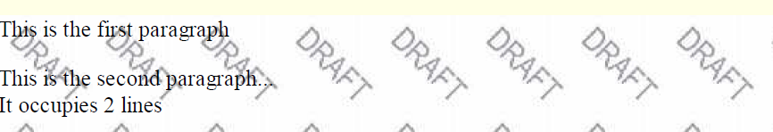
background-image
body {
background-image: url("images/draft.jpg");
}
CSS
background image/color fills the element's content area

Slide 41

background-repeat
body {
background-image: url("images/draft.jpg");
background-repeat: repeat-x;
}
CSS
can be repeat (default), repeat-x, repeat-y, or no-repeat

Slide 42
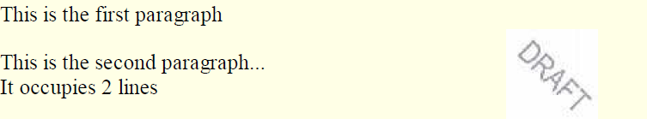
background-position
body {
background-image: url("images/draft.jpg");
background-repeat: no-repeat;
background-position: 370px 20px;
} CSS
value consists of two tokens, each of which can be top, left, right, bottom, center, a percentage, or a length value in px, pt, etc.
value can be negative to shift left/up by a given amount

Slide 43
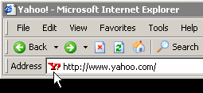
Aside: Favorites icon ("favicon")
<link href="filename" type="MIME type" rel="shortcut icon" /> HTML
<link href="yahoo.gif" type="image/gif" rel="shortcut icon" /> HTML
The link tag, placed in the HTML page's head section, can specify an icon
this icon will be placed in the browser title bar and bookmark/favorite

Slide 44
CSS Box Model
Every rendered element occupies a box:
(or outer edge)
(or inner edge)

Slide 45
CSS Box Model

Slide 46
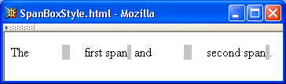
CSS Box Model

Slide 47
CSS Box Model

Slide 48
CSS Box Model

Slide 49
CSS Box Model

Slide 50
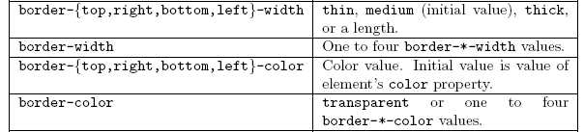
CSS Box Model

Slide 51
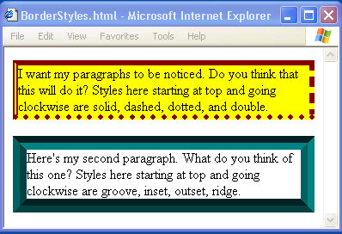
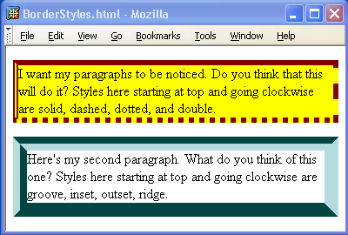
CSS Box Model

Slide 52
CSS Box Model

Slide 53
CSS Box Model
If multiple declarations apply to a property, the last declaration overrides earlier specifications
Left border is 30px wide,
inset style, and red

